Slide 1
Future Parking
The Futuristic Approach to Parking

Slide 2
Who are Future Parking and what do we offer?
Future Parking was founded in 2018 by Joe Evans.
Future Parking operate carparks around the United Kingdom, specialising in ANPR (Automatic Number Plate Recognition) technology. We pride ourselves on great customer service and fairness. We are members of the BPA approved operator scheme.
We offer a full installation and management package to your specification. We look after all maintenance aspects of your car park; including white lining, signage, revenue collection. Our own manufactured Pay Stations are installed in numerous ANPR controlled car parks we manage across the UK.
We provide a full cash collection service including counting and banking.
We have our own service and maintenance engineers and carry all machine parts.

Slide 3
Future Parking work in partnership with you:
Covering various sites nationwide across a variety of sectors including pubs/restaurants and theme park/fun fairs.
Full UK nationwide coverage
Providing unique Future Parking solutions and strategy's on a site-by-site basis
Revenue generation
Customer focused
Bespoke car parking equipment manufactured in house

Slide 4
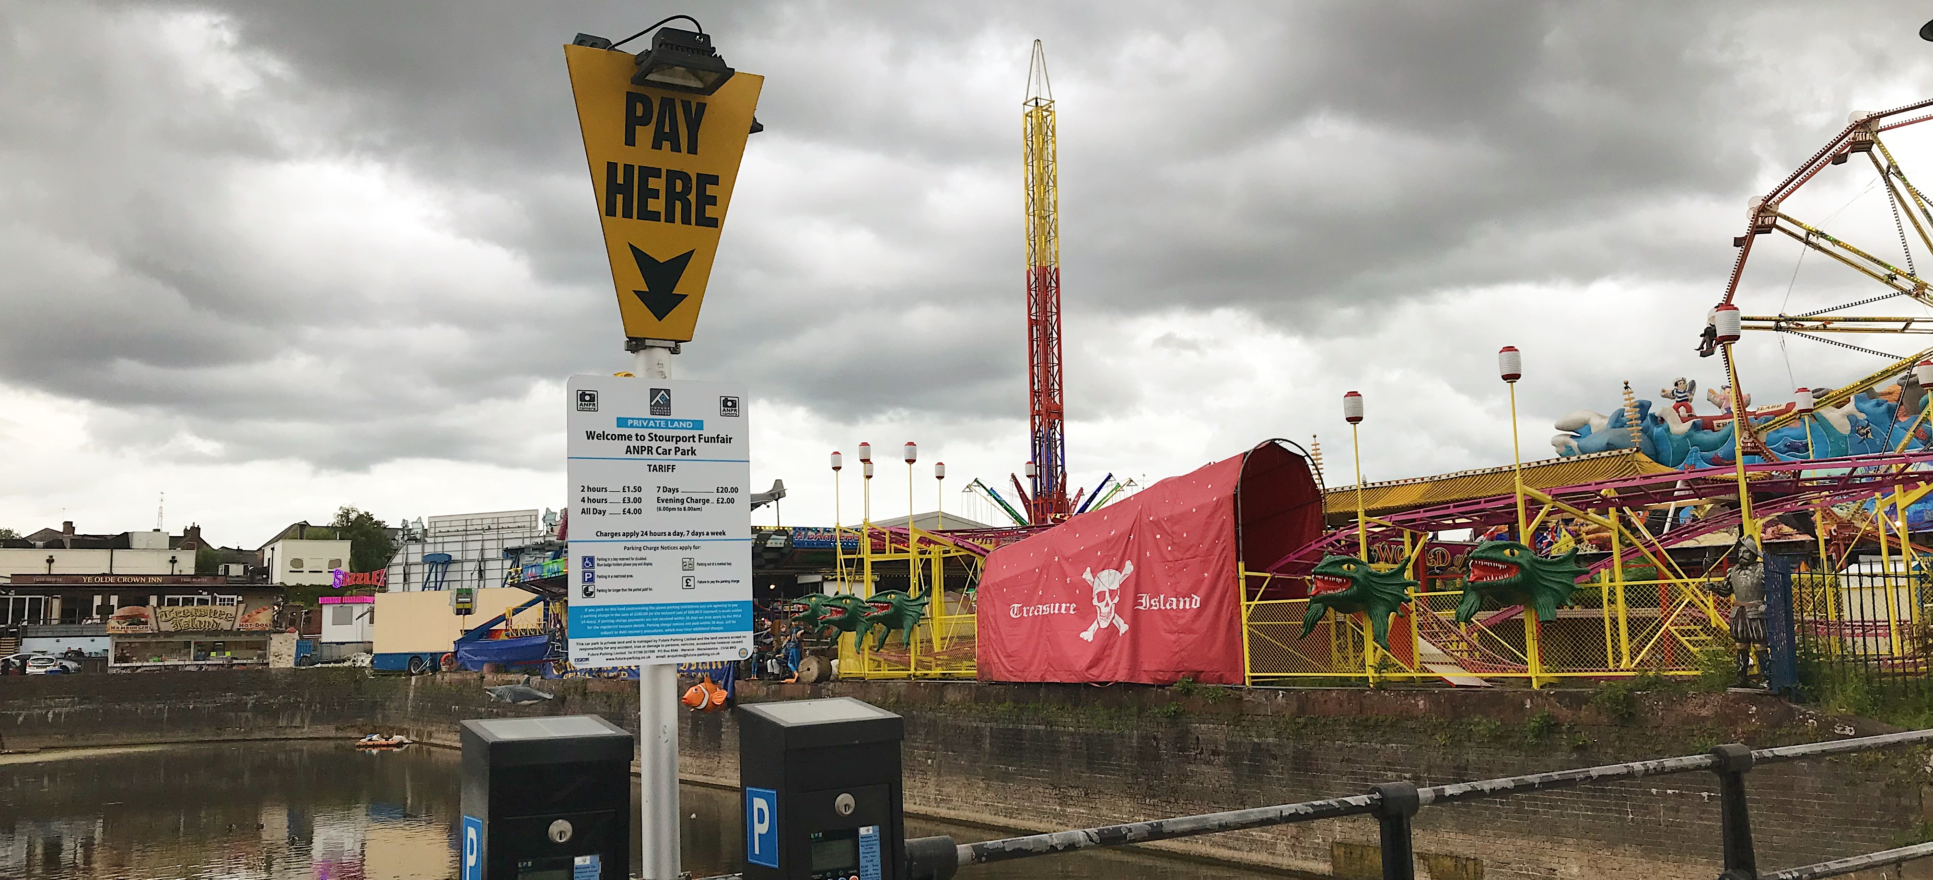
Method
1. On entry to the site, the vehicles registration mark is captured by the ANPR camera and sent to iView and the pay stations.
2. Car park users using the car park pay on departure by visiting the machine and entering their registration number.
3. The pay station will tell them their length of stay and the fee.
4. The customer makes payment by cash or card.
5. The customer returns to their car and leaves the car park. On exiting the site, the vehicles registration mark is captured by the ANPR camera and sent to iView.
Drivers enters car park and vehicle is recorded via ANPR camera.

Slide 5
ANPR
Customer enters the car park – ANPR camera reads number plate and sends to back office
Customer goes about business
Advantages - 24/7 revenue collection - Increased security - Pay on exit – the customer only pays for the duration of time they used the car park.
- Entry and exit data is validated by iView and PCN’s are automatically sent to non paying users
Customer visits payment kiosk before exit and enters registration number – then makes payment
Customer exits the car park. The ANPR camera captures the number plate and sends to back office

Slide 6
Our Service
Installation
Free Site survey
Free installation
Equipment sales
Pay and display machines
ANPR kiosks
Machine parts and consumables
Barcode scanner
Car park management
ANPR
Permit only
24 hour online patrolling
Pay by Phone
Special Event Parking
Payment
Cash / Card / Contactless
Pay by phone
Internet
Through the office
Cheques
Customer service
Fully staffed office, 9-5 Monday to Sunday
Appeals (POPLA)
Payments and queries
Cash
Collection
Counting
Banking
Secure tracking system
Secure Audit system
Car park maintenance
Machine maintenance
Signage
White lining
Engineering / Maintenance
7 day a week response
UK wide coverage
Engineers carry most spares

Slide 7
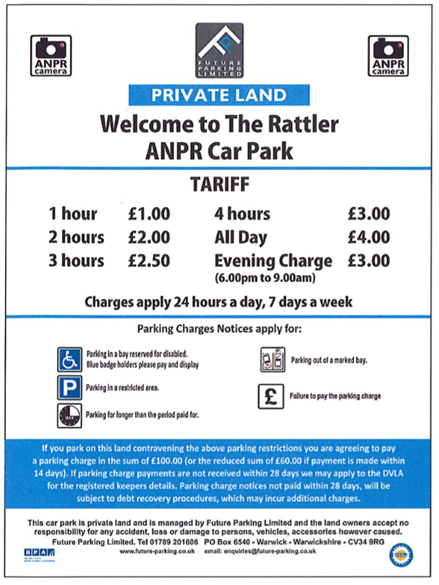
Signage
Tariff Sign
Entrance and Tariff Sign
Please see to the right, examples of our car park signage, all signage is uniquely designed for each site. Signage is dual branded and features in the client colour.

Slide 8
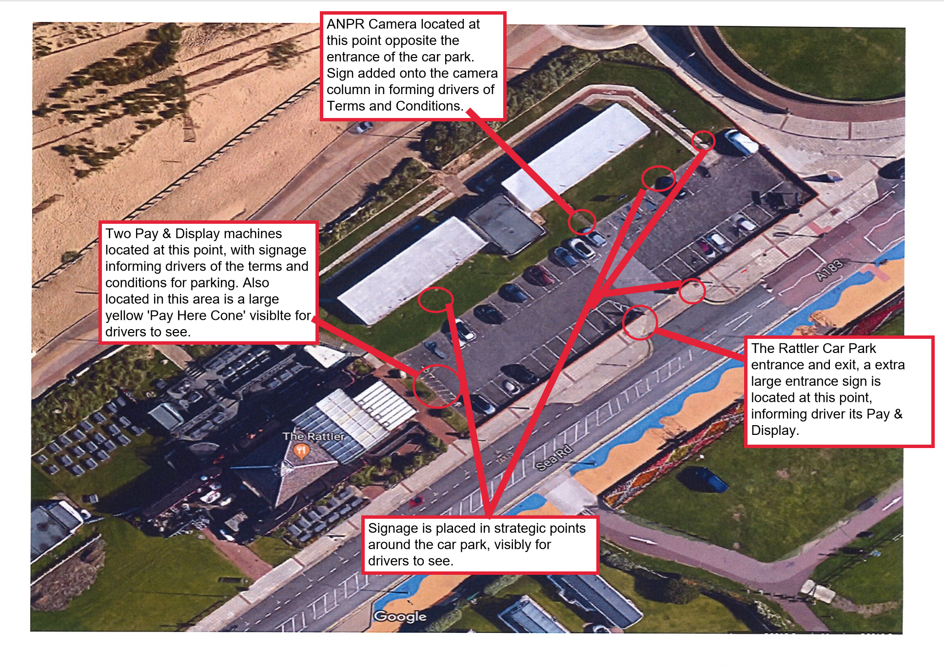
The Rattler, Newcastle-Upon-Tyne Case Study
Free survey and installation
Reliable cameras and latest payment terminal
Increased security
Pay on exit or arrival

Slide 9
CONTACT
If you would like to discuss this further or to find out more about our services, please get in touch:
For more information please visit:
www.future-parking.co.uk
Tel: 01789 201606
Email: enquiries@future-parking.co.uk

